Slide 1
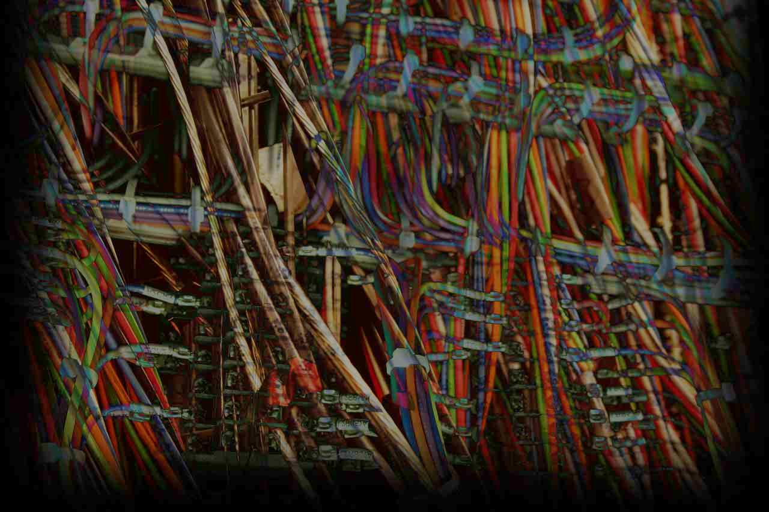


Taken Out of Context:
Language Theoretic Security
& Potential Applications for ICS
Darren Highfill, UtiliSec
Sergey Bratus, Dartmouth
Meredith Patterson, Upstanding Hackers
darren@utilisec.com
sergey@cs.dartmouth.edu
clonearmy@gmail.com

Slide 2
What’s the Problem?
How do we distinguish between benign and malicious input?
Trial and error → accumulation of malicious code profiles
What do we do about new exploits?
Trust the source
What happens when our source is compromised?
Bottom Line: Given a specific input, can we determine if it is safe to process?

Slide 3
Foundational Concepts
The Halting Problem
“Given a description of an arbitrary computer program, decide whether the program finishes running or continues to run forever.”
Alan Turing proved no algorithm can exist which will always correctly decide whether a given arbitrary program and its input will halt
Any such algorithm can be made to contradict itself, and therefore cannot be correct.

Slide 4
Foundational Concepts
Parsing vs. Processing
Simple: it matches or it doesn’t
Harder: it can match multiple different things
Complex: matching depends on other information
Do we need to execute any “if” logic?
Separating the parsing from the processing turns out to be an achievable* and valuable step
“Sufficiently complex input is indistinguishable from executable byte code.”

Slide 5
Foundational Concepts
Shotgun Parsers
Many parsers do all kinds of input checking
Unfortunately, much of this input checking is scattered all over the program
Have a dense-enough collection of checks, and you are likely to hit most things
Fuzzing
Tends to find the white space between the individual pellet marks
In a way, is the inverse of defining valid input

Slide 6
Foundational Concepts
Language Formalism
Noam Chomsky: containment hierarchy of formal grammars
Regular
Context Free
Context Sensitive
Recursively Enumerable
Context Dependency
Do you have to have additional information to determine value or meaning?

Slide 7
Foundational Concepts
Weird Machines
Hidden functionality unintentionally built into a device
Discovered by security researchers
Distinct from reprogramming
Using the intended functionality in unintended ways
Hypothesis: Machine A has a hidden Machine B inside
Exploit is proof of existence of Machine B

Slide 8
From Concepts to Technology
[Sergey]

Slide 9
Using the Technology
[Meredith]

Slide 10
Conclusion
Potential Applications
Open-source library of input parsers
Vendors can re-use well-examined code (instead of having to re-write)
Refinement of fuzz-testing tools
Variations based on input-parsing definition
Impact
Moving toward whitelisting-style input validation
Proven track record of bug reduction

